Slide 1
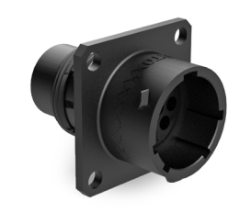
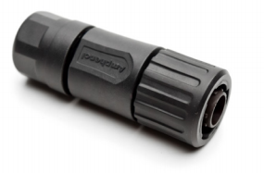
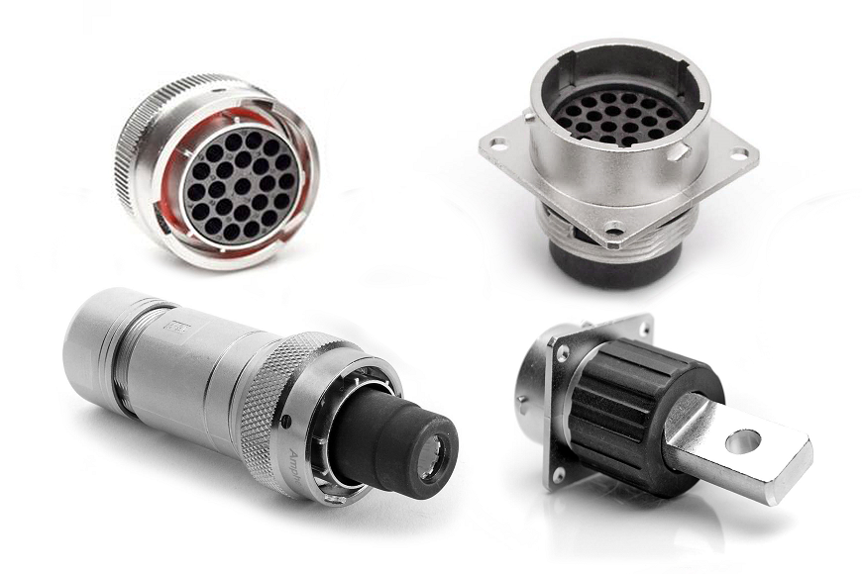
Ecomate - RT360 Series
RT360 industrial circular connectors are designed to meet the requirements of MIL-C-26482 series military specification. Based on our superior build quality, high-performance capabilities, it has been developed to be completely compatible with all other existing standard products industry-wide. This series is a wide used connectors for the automotive, electric vehicles, robotics, military, welding industries and other demanding interconnect applications.
Technical Data
Operating Temperature: ： -40°C to +105°C or -40°C to +125°C
Suitable For Indoor and Outdoor Applications
500 Mating Cycles
IP67&IP69K rated in mated condition
Circular metal bayonet lock. Able to withstand extreme vibration
and mechanical shock.
Alternate keying positions available. Five positions (N, W, X, Y, Z)
EMI/RMI shielding capability with appropriate backshell / Unshielded capability with plastic end cap
UL1977. ROHS compliant

Slide 2
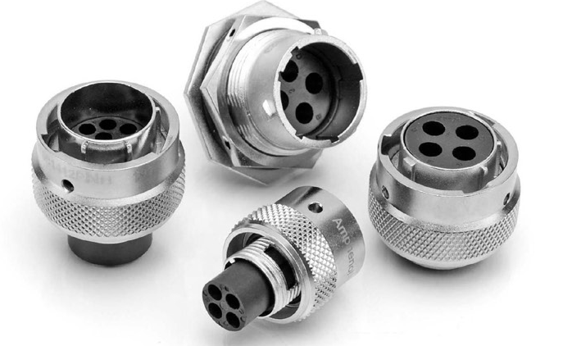
RT Series
Technical Data
8 shell sizes & 23 insert configurations
With standard insert arrangements & mixed power and signal arrangements.
8 contact size, Rated Voltage 500V AC/DC, 45A, 10~12AWG
2.5mm contact size, Rated Voltage 500V AC/DC, 23A, 12~14AWG
16 contact size, Rated Voltage 500V AC/DC, 13A, 14~26AWG
20 contact size, Rated Voltage 250V AC/DC, 7.5A(machined), 5A(stamped & formed), 20~30AWG

Slide 3
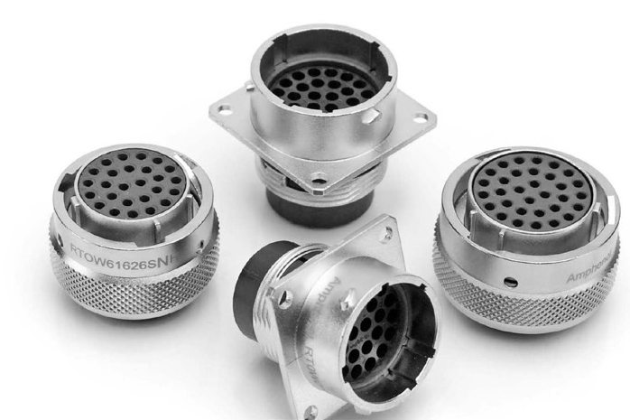
RT0W Series
Technical Data
Mated with MIL-C-26482 series connector
5 shell sizes & 5 insert configurations
High density arrangements from 6~32 contacts.
20 contact size, Rated voltage 250V AC/DC, Rated current 7.5A(machined), 5A(stamped & formed), 20~30AWG

Slide 4
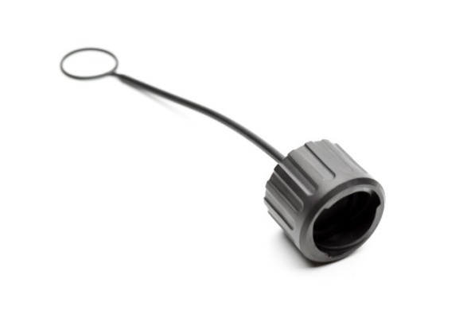
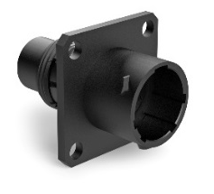
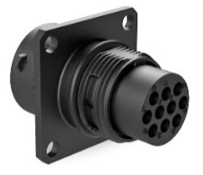
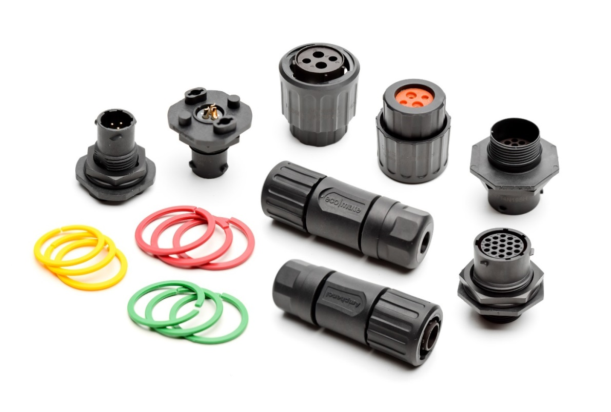
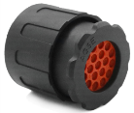
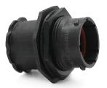
RTS Series
Technical Data
6 shell sizes
With standard insert arrangements & mixed power and signal arrangements.
8 contact size, Rated voltage 500V AC/DC, Rated current 45A, 10~12AWG
2.5mm contact size, Rated voltage 500V AC/DC, Rated current 23A, 12~14AWG
16 contact size, Rated voltage 500V AC/DC, Rated current 13A, 14~26AWG
20 contact size, Rated voltage 250V AC/DC, Rated current 7.5A(machined), 5A(stamped & formed), 20~30AWG

Slide 5
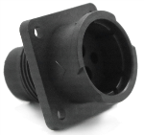
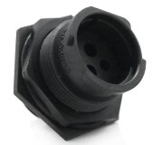
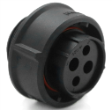
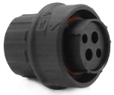
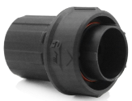
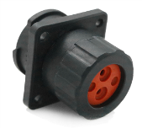
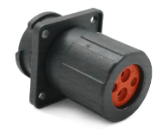
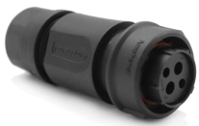
FLS Series
Technical Data
3 shell sizes
With standard insert arrangements & mixed power and signal arrangements.
8 contact size, Rated voltage 500V AC/DC, Rated current 45A, 10~12AWG
2.5mm contact size, Rated voltage 500V AC/DC, Rated current 23A, 12~14AWG
16 contact size, Rated voltage 500V AC/DC, Rated current 13A, 14~26AWG
20 contact size, Rated voltage 250V AC/DC, Rated current 7.5A(machined), 5A(stamped & formed), 20~30AWG

Slide 6
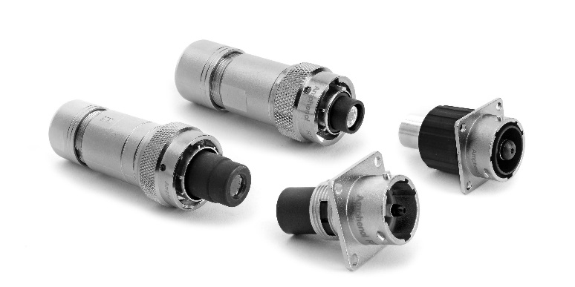
RTHP Series
Technical Data
4 Shell Sizes • High Reliability
Features Amphenol’s RADSOK® contact technology
Single Pole High Power Arrangements; 3.6mm-10mm Contact Sizes
3.6mm contact size, Rated voltage 630V AC/DC , Rated current 86A
6.0mm contact size, Rated voltage 630V AC/DC , Rated current 120A
8.0mm contact size, Rated voltage 630V AC/DC , Rated current 180A
10.0mm contact size, Rated voltage 630V AC/DC , Rated current 300A

Slide 7
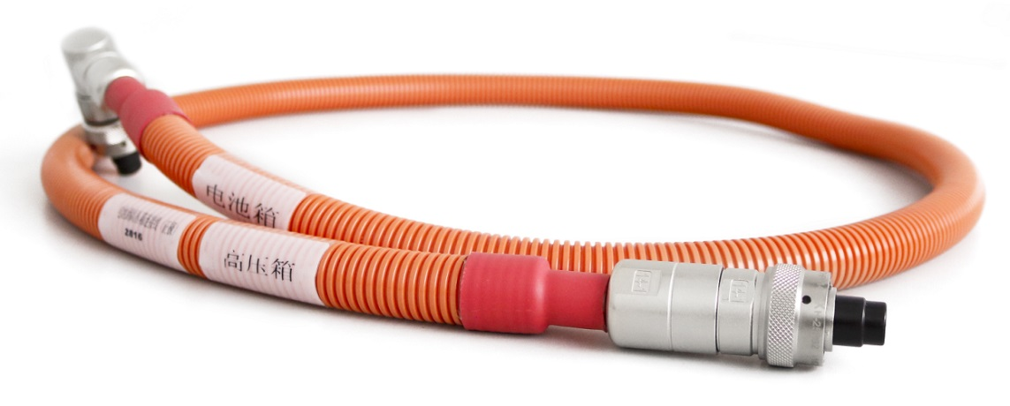
Cable assembly with RTHP connectors

Slide 8
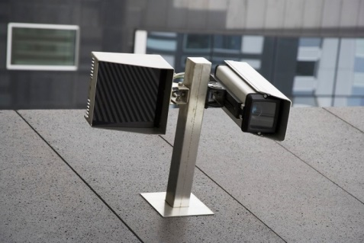
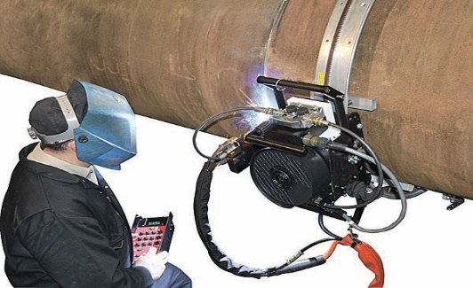
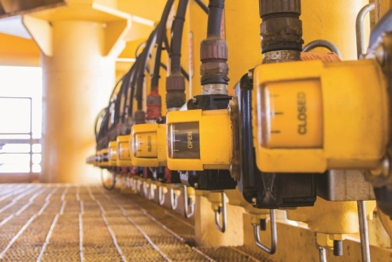
Applications of RT360 series
Medical
Welding
Building Automation
& Control
Robotics
Telecom -Data
Infrastructure
Instrumentation Measurement
RT360 series

Slide 9
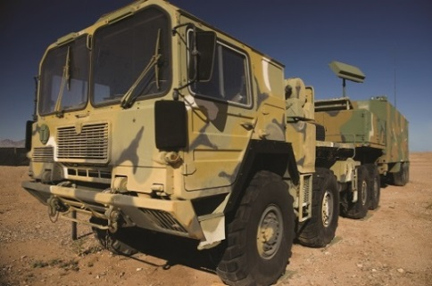
Applications of RT360 series
Energy –
Power
Railway
Aerospace
Military
Electric Vehicles
Automotive
RT360 series

Slide 10
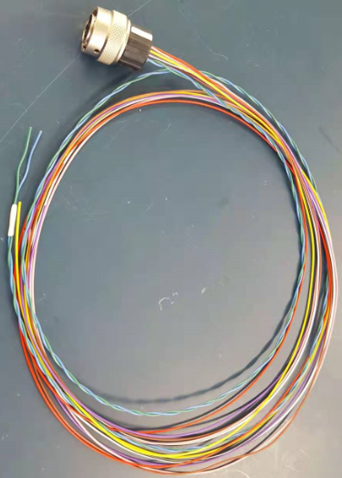
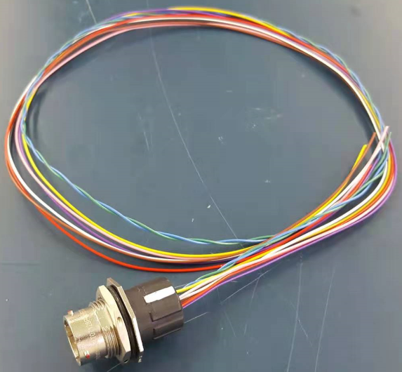
RT360 series success story
Country: Japan
Application: Electric car batteries
Product: P80939, P80940

Slide 11
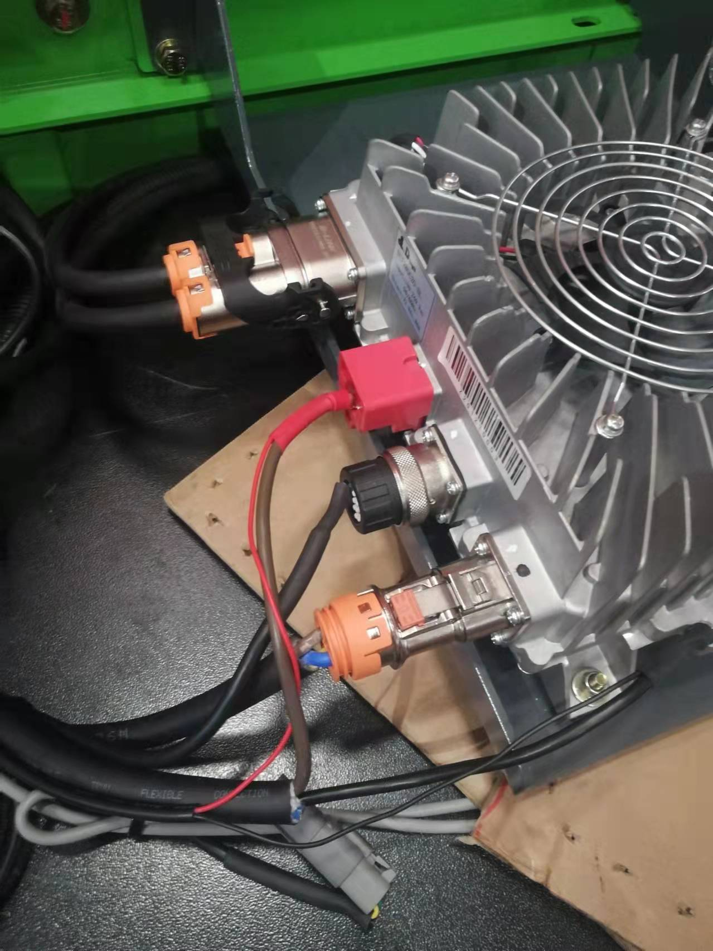
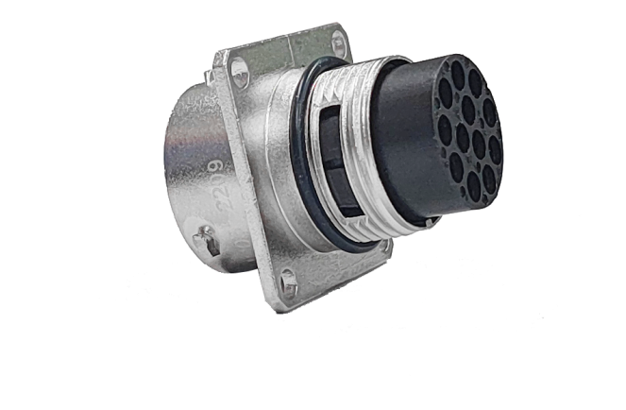
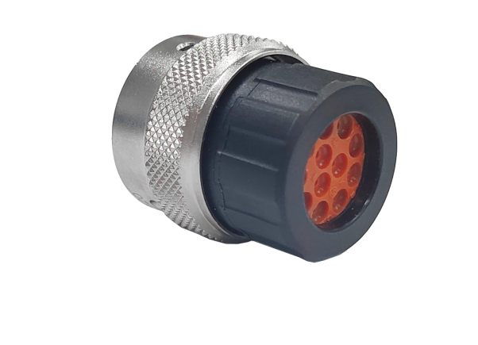
RT360 series success story
Country: China
Application: Electric climbing vehicle
Product: RT14-12

Slide 12
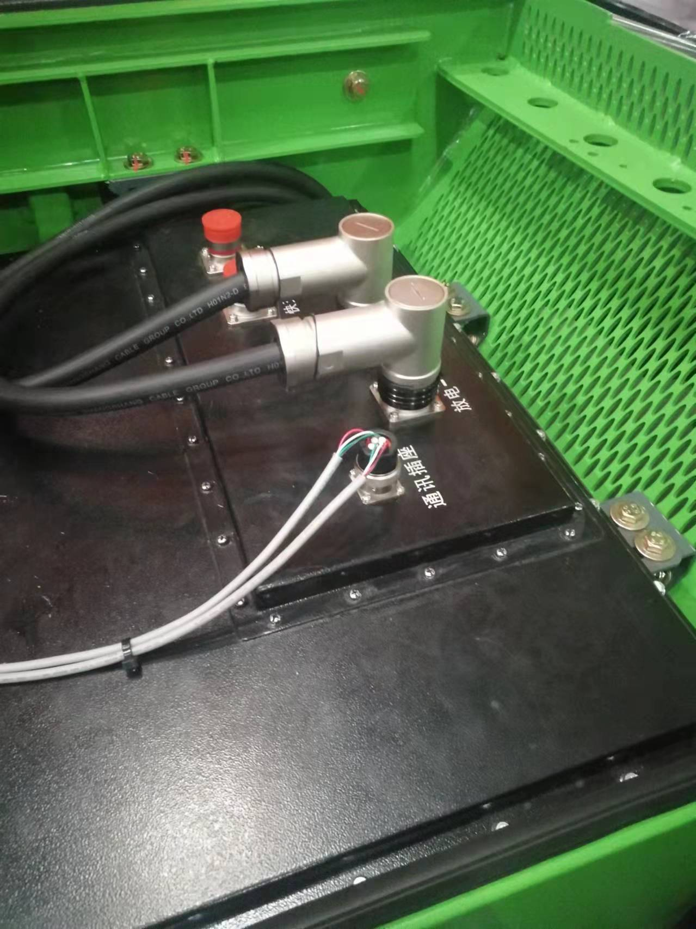
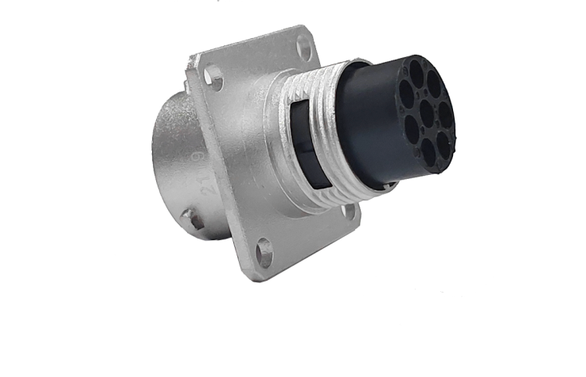
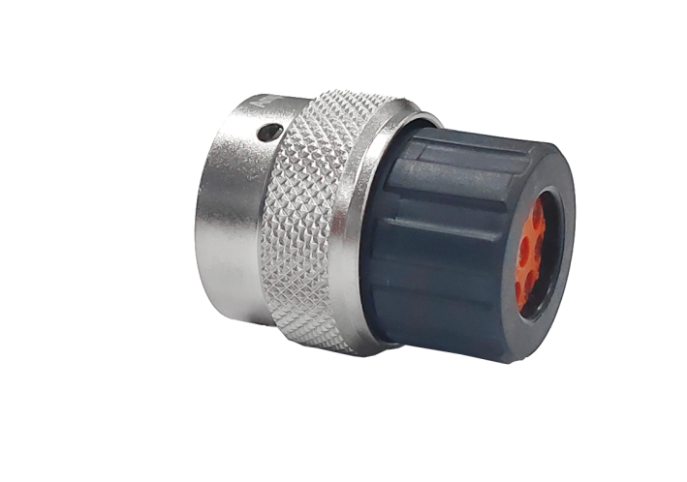
RT360 series success story
Country: China
Application: Battery pack
Product: RT12-8

Slide 13
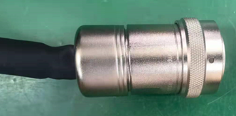
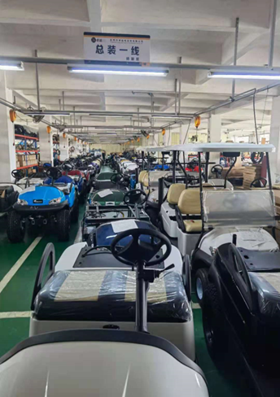
RT360 series success story
Country: China
Application: PDU distribution box, excellence golf cart
Product: RT22-28

Slide 14
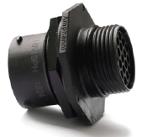
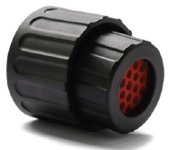
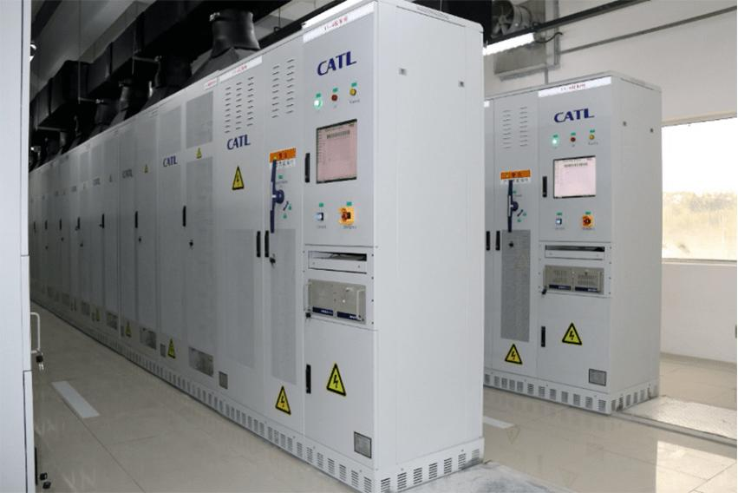
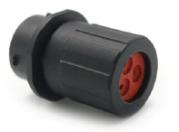
RT360 series success story
Country: China
Application: Power battery system
Product: RTS/AT2P/ATP2P

Slide 15
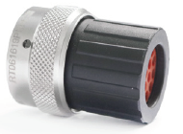
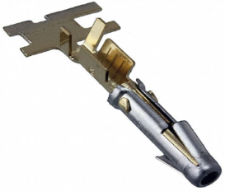
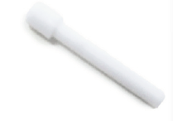
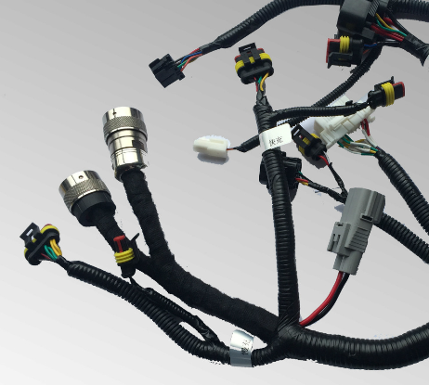
RT360 series success story
Country: India
Application: Electric vehicle wiring harness
Product: RTS/AT2P/ATP2P

Slide 16
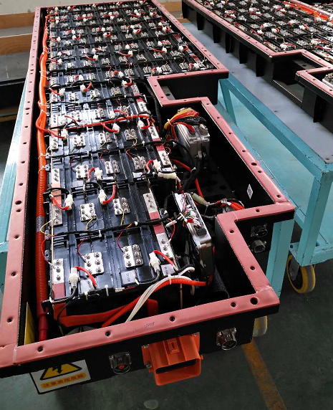
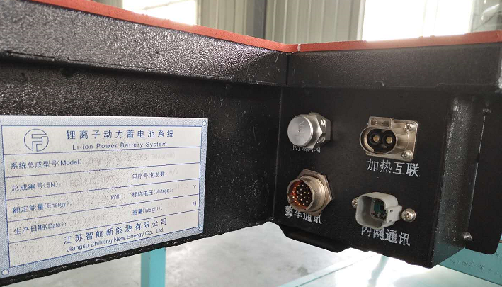
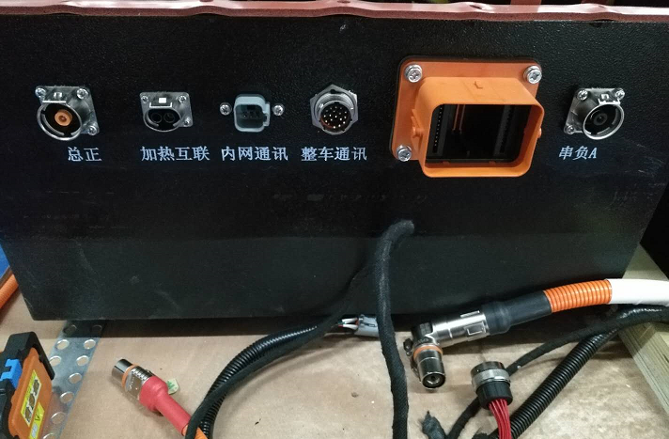
RT360 series success story
Country: China
Application : Battery Pack
Product: RT 16-19, AT 6PIN

Slide 17
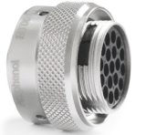
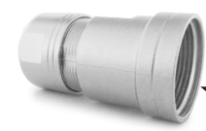
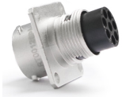
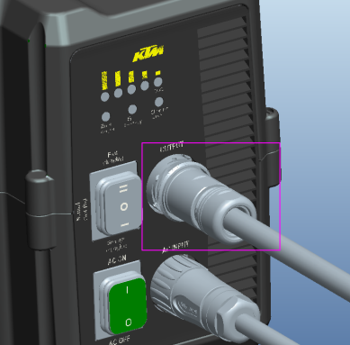
RT360 series success story
Country: China
Application : Electric off-road motor
Product: RT 4P, 9P &RT0W 10 P

Slide 18
RT360 series success story
Country: China
Application : EV Car
Product: RTS 10-6 & RT 12-8

Slide 19
RT360 series success story
Country: China
Application : EV Car(lin-box)
Product: RT 12-2, 12-4, 12-8, 14-3,14-4

Slide 20
RT360 series success story
Country: China
Application : OBC
Product: RT 2P,4P,6P & 8P

Slide 21
RT360 series success story
Country: China
Application : Motor low voltage signal line
Product: RT 16-19

Slide 22
RT360 series success story
Country: China
Application : Rail transit gate control system
Product: RT series

Slide 23
RT360 series success story
Country: China
Application : The control system of maglev train
Product: RT series

Slide 24
RT360 series success story
Country: China
Application : EMU controller and smoke control system
Product: AEM & RT series

Slide 25
RT360 series success story
Country: China
Application : Cable assembly on EV BUS
Product: RT series

Slide 26
RT360 series success story
Country: China
Application : Electric motor control system
Product: RTHP0161P*, RTHP6161S*

Slide 27
RT360 series success story
Country: China
Application : Battery park
Product: RTHP6161

Slide 28
RT360 series success story
Country: China
Application : High-voltage board
Product: RTHP16-1/RT-1619/RT-164/RT-144

Slide 29
RT360 series success story
Country: China
Application : Machine controller
Product: RTHP16-1
Country: China
Application : Battery
Product: RTHP16-1

Slide 30
RT360 series success story
Country: China
Application : Robot wire harness
Product: RT series
Country: China
Application : Robot
Product: RT series

Slide 31
RTS series success story
Country: China
Application: Automotive Monitoring Systems
Product: RTS 14-12

Slide 32
A series connectors
Designed with SAE-J2030, Amphenol Sine connectors A series are a high-performance, cost-effective solution able to be used in a variety of interconnect applications: Heavy Duty, Transportation, Marine, Diagnostic, Military, Alternative Energy and Agricultural.
Technical Data
Operating Temperature: ： -55°C to +125°C
Suitable For Indoor and Outdoor Applications
100 Mating Cycles
IP67&IP69K rated in mated condition
UL1977. ROHS compliant

Slide 33
AT Series
Technical Data
2, 3, 4, 6, 8, 12 ,15, 18 positions available
Rating voltage: 250V AC/DC according to IEC
500V AC/DC according to UL 1977
16 contact size, 13A, 14~20AWG
Wire to panel, wire to wire available
Thermoplastic, Flammability Rating: UL94, V-0

Slide 34
ATM Series
Technical Data
2, 3, 4, 6, 8, 12 positions available
Rating voltage: 250V AC/DC according to IEC
500V AC/DC according to UL 1977
20 contact size, 7.5A, 16~22AWG
Wire to panel, wire to wire available
Thermoplastic, Flammability Rating: UL94, V-0

Slide 35
ATP Series
Technical Data
2, 4, 6 positions available
Rating voltage: 250V AC/DC according to IEC
500V AC/DC according to UL 1977
12 contact size, 25A, 10~14 AWG
Wire to panel, wire to wire available
Thermoplastic, Flammability Rating: UL94, V-0

Slide 36
ATV Series
Technical Data
18 positions available
Rating voltage: 250V AC/DC according to IEC
500V AC/DC according to UL 1977
16 contact size, 13A, 14~20AWG
Wire to panel, wire to wire available
Thermoplastic, Flammability Rating: UL94, V-0

Slide 37
ATV Series
Technical Data
Application：BMS and Controller Box
38 positions available
Rating voltage: 250V AC/DC according to IEC
500V AC/DC according to UL 1977
16 contact size, 6 power contacts, 13A, 14~26AWG
32 power contacts, 2A, 20~22AWG
Wire to panel available
Thermoplastic, Flammability Rating: UL94, V-0

Slide 38
AHD Series
Technical Data
6,9 positions available
Rating voltage: 250V AC/DC according to IEC
500V AC/DC according to UL 1977
6 position: match with 12 contact size , 25A, 10~14AWG
9 position: match with 16 contact size, 13A, 14~20AWG
High-performance, cost-effective
SAE J1939 protocol standard
Ideal for controlled/uncontrolled environmental conditions

Slide 39
AHDP Series
Technical Data
24 Shell: 7, 9, 18, 19, 21, 23, 27, 29, 31, 35, 47,91 positions available
18 Shell: 6, 8, 14, 20, 21 position available
Rating voltage: 250V AC/DC according to UL 1977
4 contact size, 100A, 6AWG
8 contact size, 60A, 10~12AWG
12 contact size, 25A, 10~14AWG
16 contact size, 13A, 14~20AWG
20 contact size, 7.5A, 16~22AWG
High density signal and mixed power insert configurations
Bulkhead mounting or In-line
Reverse and standard arrangements

Slide 40
AHDM Series
Technical Data
24 Shell: 7, 9, 18, 19, 21, 23, 27, 29, 31, 35, 47,91 positions available
18 Shell: 6, 8, 14, 20, 21 position available
Rating voltage: 250V AC/DC according to UL 1977
4 contact size, 100A, 6AWG
8 contact size, 60A, 10~12AWG
12 contact size, 25A, 10~14AWG
16 contact size, 13A, 14~20AWG
20 contact size, 7.5A, 16~22AWG
High density signal and mixed power insert configurations
Bulkhead mounting or In-line
Reverse and standard arrangements

Slide 41
Plastic PanelMate connectors
Technical Data
AT series 2, 3, 4, 6, 8, 12 , 18 positions: 16 contact size, 13A
AT series 13 position: 12 contact size, 25A; 16 contact size, 13A
ATP series 2 and 4 positions: 12 contact size, 25A
ATV series 18 positions: 16 contact size, 13A
ATM series 12 positions : 20 contact size, 7.5A
ATHD series 8# 12# panel waterproof connector
Harsh environment applications

Slide 42
Flange Mount series
Technical Data
AT series 2, 3, 4, 6, 8, 12 positions: 16 contact size, 13A
ATM series 12 position: 20 contact size, 7.5A
Harsh environment applications

Slide 43
ATHD Series
Technical Data
Single position
Rating voltage: 250V AC/DC according to IEC
600V AC/DC according to UL 1977
4 contact size，100A ， 6AWG
8 contact size，60A ， 8~10AWG
12 contact size，25A ， 10~14AWG
Wire to panel, wire to wire available

Slide 44
AT Speed Splices series
Our AT Speed Splices offer a unique single terminal solution, which is designed to protect connections from dirt, dust, and water immersion up to 1 meter. Used in harsh environments, such as the construction, mining, marine, and agricultural industries, Jiffy Splices are easy to install and help quickly repair damaged electrical connections on equipment at the jobsite. options.
Technical Data
Single position
12 contact size，25A ， 12~14AWG
16 contact size，25A ， 12~14AWG

Slide 45
PCB series
The AT Family offers printed circuit board (PCB) connectors that are heavy duty environmentally sealed connectors designed for wire-to-circuit board connections. Available in a variety of styles for the AT and ATM connector series, Amphenol PCB connectors cover a range of pin counts from 2 to 12 and wire gauges from 14 to 22. Many of the connectors are available in straight or 90° pin options.
Technical Data
AT series 2, 4, 6, 8, 12 ,13 ,18 positions
ATM series 2, 3, 4, 6, 8, 12 positions
ATP series 2,4 positions
Straight or 90°pin options

Slide 46
Hyperbuss series
HYPERBUSS is bussing product which based on our AT series, all power or data to be fed into a connector through one or more terminals. Provide multiple independent electrical circuits. The connectors are available in multiple buss configurations using standard size 16 contacts, with plating options in nickel or gold.
A single HYPERBUSS connector can replace several standard connectors or splices, saving space, wiring, and weight.
HYPERBUSS product be able to mating with AT plug, meet all performance specifications for AT series.
Technical Data
AT series 2, 4, 6, 8, 12 positions
Distribute the current

Slide 47
Extended Body AT Plugs Designed for Overmolding
Custom Cable Assemblies are available for any application, and carry with them the capabilities of being overmolded in any size or length necessary. 2 pin, 4 pin, 6 pin, 8 pin and 12pin overmold connectors are available now, which are developed for overmolding cable assembly easily.

Slide 48
With diode and resistor series
Amphenol AT connectors with diodes and resistors are useful anywhere you need to regulate power or protect a device against a potential power surge.
A diode allows current to flow in one direction only. By preventing current from traveling a circuit in the wrong direction, a diode can protect an electronic device from damage.
Resistors protect sensitive electronics by limiting the amount of electricity that can flow to the device through the resistor, and therefore preventing power spikes.
Technical Data
AT series 2, 4 positions available.

Slide 49
2 position LED optional
Designed for electromechanical applications where a visible LED light is integrated into a 2 position plug allowing the user to determine the device is receiving power. Environmentally sealed, field serviceable and cost effective while reducing costly trouble shooting time. 12V and 24V versions available. Diode protected.

Slide 50
ARMOR IPX series
ARMOR IPX product that accept snap-in headers are available. The enclosure features a through hole mounting flange.
Existing PCB connectors：ATM 2x12/12 pin，AT 12,24,36,48 pin

Slide 51
Boots
Boots provide a professional looking finishing touch for A series connectors. Made of durable plastic, these slip-on boots are not only aesthetically appealing, but also provide increased protection from dirt, paint overspray, and pressure washing. The plastic boots arerated from -29°C to +100°C and offer a slip-on design making installation quick and easy.

Slide 52
ARC Series
The ARC series is a series of rectangular connectors currently available in 24/40/70 holes with 16# terminals. The connector does not require a wedge lock. Terminals are inserted and removed in the same way as the AHDP series. Terminals are removed using AT11-310-1605.

Slide 53
ATHP Series
Technical Data
Features Amphenol’s RADSOK® contact technology
HVIL with shielding and unshielded solutions
Rating voltage：1000V AC/DC
Test voltage： 5000V AC/DC
Current rating of 20A for the 2.5mm² wire, 25A for the 4mm² wire, 35A for the 6mm² wire, 180A for the 50mm² wire.
Mating cycles：250+
IP67 & IP 69K rated in mated condition

Slide 54
ATHP Series
Technical Data
Quick lock and press-to-release design
360°rotating plug
Various termination option(Threaded, Crimp, Busbar)
Compact robust design
Rating voltage：1000V AC/DC
8.0mm contact，50mm² @ 180A
35mm² @ 130A
25mm² @ 120A
Mating cycles: 200+
IP67 rated in mated condition

Slide 55
Optional accessories

Slide 56
Custom Cable Assembly - signal transmission

Slide 57
Applications of A series
Automotive
HEAVY EQUIPMENT
AGRICULTURE
POWER GENERATION
HARSH ENVIRONMENT
MARINE
Diagnostics
Mining
WATER RESISTANT
Railway

Slide 58
A series success story
Country: China
Application: Intelligent control box
Product: AT 26pin

Slide 59
A series success story
Country: China
Application: Solar Panel for Vehicle
Product: ATP 2P

Slide 60
ATHP series success story
Country: China
Application: Battery pack
Product: ATHP 2.5

Slide 61
A series success story
Country: China
Application: Hydraulic equipment
Product: AT series

Slide 62
A series success story
Country: China
Application: LED Light for Vehicle
Product: AT 2-6P & ATP 2/4P

Slide 63
A series success story
Country: South Africa
Application: Automobile
Product: AHDP & AHDM

Slide 64
A series success story
Country: Japan
Application: Excavator
Product: A series

Slide 65
A series success story
Country: China
Application: Agricultural machinery
Product: AT13/AT15

Slide 66
A series success story
Country: China
Application: Engine cable harness
Product: Cylinder piercing parts (A series customized)

Slide 67
A series success story
Country: China
Application: Heavy truck engine wiring harness
Product: AT series

Slide 68
A series success story
Country: China
Application: High pressure box ,Electric sanitation vehicle
Product: AT04-2P-PM11

Slide 69
A series success story
Country: China
Application: On-board gating system wiring harness
Product: AT series

Slide 70
A series success story
Country: China
Application: Transformer
Product: ATM 6P, 12P

Slide 71
A series success story
Country: China
Application: Mining equipment
Product: AT 4pin, 12pin & AHDP series

Slide 72
AHD series success story
Application Area: Europe
Application: Record the speed, distance and location for Bus
Product : AHD series

Slide 73
A series success story
Country : China
Application: New energy vehicle high voltage control box
Product: AT panel & RT series

Slide 74
A series success story
Country : USA
Application: BMS for Marine equipment
Product: ATV 18PIN

Slide 75
A series success story
Country : China
Application: Cotton Picker transmission wire harness
Product: AT LED 2PIN

Slide 76
Servo control connectors - Motion series
The M Series™ MotionGrade™ DIN Style Connectors are ideally suited for advanced servo drive encoder feedback applications, packaging, robotic, printing, machine tool, medical and automation environments where control signal transmission or power are required in a robust and compact delivery system.
The first generation M23 threaded connectors
6, 8, 9, 12, 16, 17 and 19 positions available
10A Max Current; 160V (12 pos), 125V (16-17 pos); 18-26AWG (12-17 pos)
30A Max Current; 630V Max Voltage; 14-16AWG (6-9 pos)
Standard Design: Fixed rear insertion design
Standard Design: Back cap removal
Standard Design: Installation occurs from the bottom of base through the back of the shell.
Standard Design: Traditional connector assembly
Standard Design: Extraction tools required
UL1977. ROHS Compliant

Slide 77
The second generation Checkmate series
CheckMate™ Quick-Locking System
6, 8, 9, 12, 16, 17 and 19 positions available.
Enhanced next generation anti-vibration dual-ratcheting coupling system.
Checkmate™ is intermateable and compatible with rival M23 quick coupling products.
Distinctive alignment arrows with lock/unlock identifiers (ensures a solid connection every time)
MetriFit™ Strain Relief System
The Metrifit™ Strain Relief System provides maximum 360° EMI/RFI shielding, with advanced sealing capability (IP67) suitable for harsh environments. Tamper proof design ensures a safe and secure system.

Slide 78
The third generation Elite series
M23 Elite Connectors
6, 8, 9, 12, 16, 17 and 19 positions available
10A Max Current; 160V (12 pos), 125V (16-17 pos); 18-26AWG (12-17 pos)
30A Max Current; 630V Max Voltage; 14-16AWG (6-9 pos)
UL1977, file no. is E336830 & E491265.
Elite Design: Top loading insert design; Front cap removal
Elite Design: Loose piece insert for hand held installation ease
Elite Design: Alignment tabs on the insert to help guide the insert into place
Elite Design: Two flange size options to choose from
Elite Design: No extraction tools required

Slide 79
M40 Series
M40 Standard Connectors
6 and 8 positions available
75A Max Current; 630V Max Voltage; 8-12AWG

Slide 80
Hybrid Series
Hybrid DMC™ Connectors
2 Power + PE + 1 Signal + 4 Quad Element Ethernet
18A (2.0mm), 1A (1.0mm), 0.5A (Quad Element) Max Current
850V (2.0/1.0mm Contacts), 30VDC (Quad Element) Max. Voltage
UL1977, file no. is E336830.

Slide 81
Custom cable assembly-M23 & M40

Slide 82
Applications of Motion series
INDUSTRIAL
ON-MACHINE
PACKAGING MACHINERY
DISTRIBUTED POWER
MOTION CONTROL
Printer
MEDICAL
COMMUNICATIONS

Slide 83
Servo control connectors success story
Country: Worldwide
Application: Power/Signal Distribution, VFD, Servo Motor
Product: PowerBoss Lite/Mini/Motion Cable Assy

Slide 84
Servo control connectors success story
Country: China
Application: Industry robot
Product: M23 standard series

Slide 85
Servo control connectors success story
Country: Japan
Application: Servo Motors
Product: M23 Hybrid DMC
Country: North America
Application: Power/Control for Welding Systems
Product: M23 connector and cable assembly

Slide 86
Factory Automation
Our Factory Automation - Distributed Power and Control product lines were developed in response to the need for robust, streamlined and scalable products for use in robotic and material handling systems, such as: conveyors, sorting, automated storage and retrieval, packaging, overhead transport, palletizing and any other options imaginable.

Slide 87
Custom Molded Cable Assembly Solutions
Amphenol Sine Systems offers custom molded cable assembly solutions across all our standard product lines. If one of our standard products doesn’t fit your specific needs, our Engineers will work with you to custom design a solution specific to your application. Whether you are looking for a customized connector solution, a complete turn-key cable assembly solution, custom wiring to simplify machine assembly or a specific mold color, Amphenol Sine Systems is your one source for proven, reliable and innovative results.

Slide 88
Custom Cable Assembly Solutions
Diagnostic

Slide 89
Custom Ethernet Cable Assembly Solutions
M12 & M22

Slide 90
Cable Assembly success story
Country: China
Project: plate Cabinet cable assembly
Product: cable assembly

Slide 91
AIIO China Main customers

Slide 92
AIIO China Main customers

